Slide 1
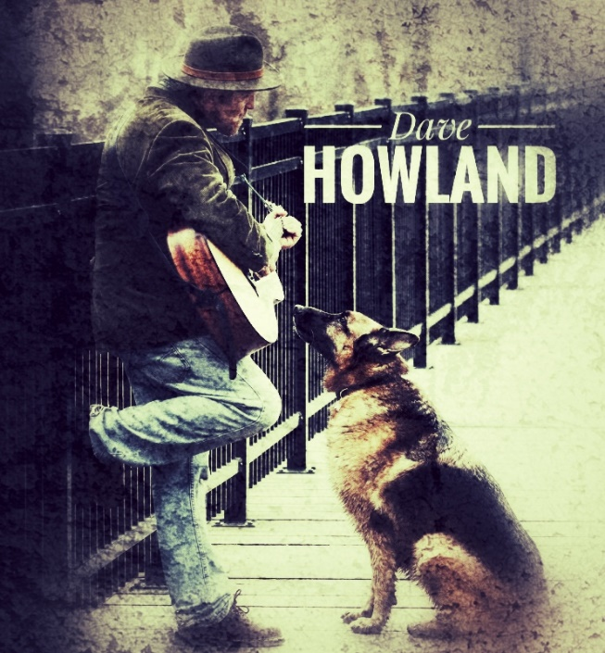
THANK YOU!
THANK YOU!
Thanks for taking a listen and providing me some feedback on my short set – a work in progress. I’d love to know what you think of the tunes and how you’d characterize them in terms of genre. Please feel free to share any impressions, suggestions or ideas here or on the back of the paper. I’m really grateful for your time and comments!
Thanks for taking a listen and providing me some feedback on my short set – a work in progress. I’d love to know what you think of the tunes and how you’d characterize them in terms of genre. Please feel free to share any impressions, suggestions or ideas here or on the back of the paper. I’m really grateful for your time and comments!
How would you describe the tune
(ex: folk, rock, country, indie)?
How would you describe the tune
(ex: folk, rock, country, indie)?
SONG
Not really diggin’ it
Really Diggin’ it!
SONG
Not really digging’ it
Really Diggin’ it!
Lightning Rod 1 2 3 4 5
I Don’t Mind 1 2 3 4 5
Move Along 1 2 3 4 5
A Secret 1 2 3 4 5
Passions 1 2 3 4 5
Berlin 1 2 3 4 5
Bring Us Your Tired 1 2 3 4 5
Lightning Rod 1 2 3 4 5
I Don’t Mind 1 2 3 4 5
Move Along 1 2 3 4 5
A Secret 1 2 3 4 5
Passions 1 2 3 4 5
Berlin 1 2 3 4 5
Bring Us Your Tired 1 2 3 4 5
COMMENTS/ SUGGESTIONS? (Feel free continue on the back!):
COMMENTS/ SUGGESTIONS? (Feel free continue on the back!):

Slide 2
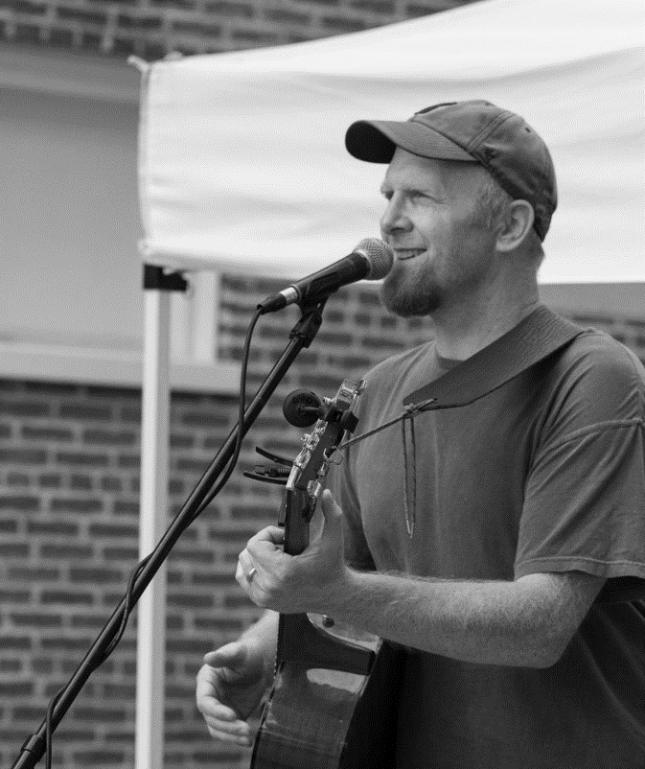

Slide 3
